Slide 1
Smarticle – Demo 2
Little about our progress since the first demo:
After the first demo we went on to create our DFD and ERD and to make the models of the project.
The idea of the division was to let every one of us to concentrate on a model and its tests luckily we had exactly 5 models.

Slide 2
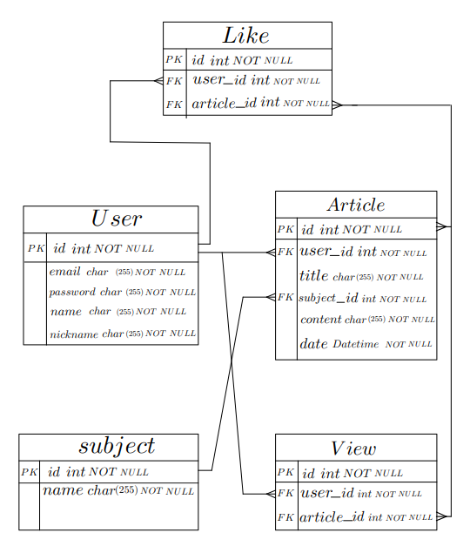
ERD

Slide 3
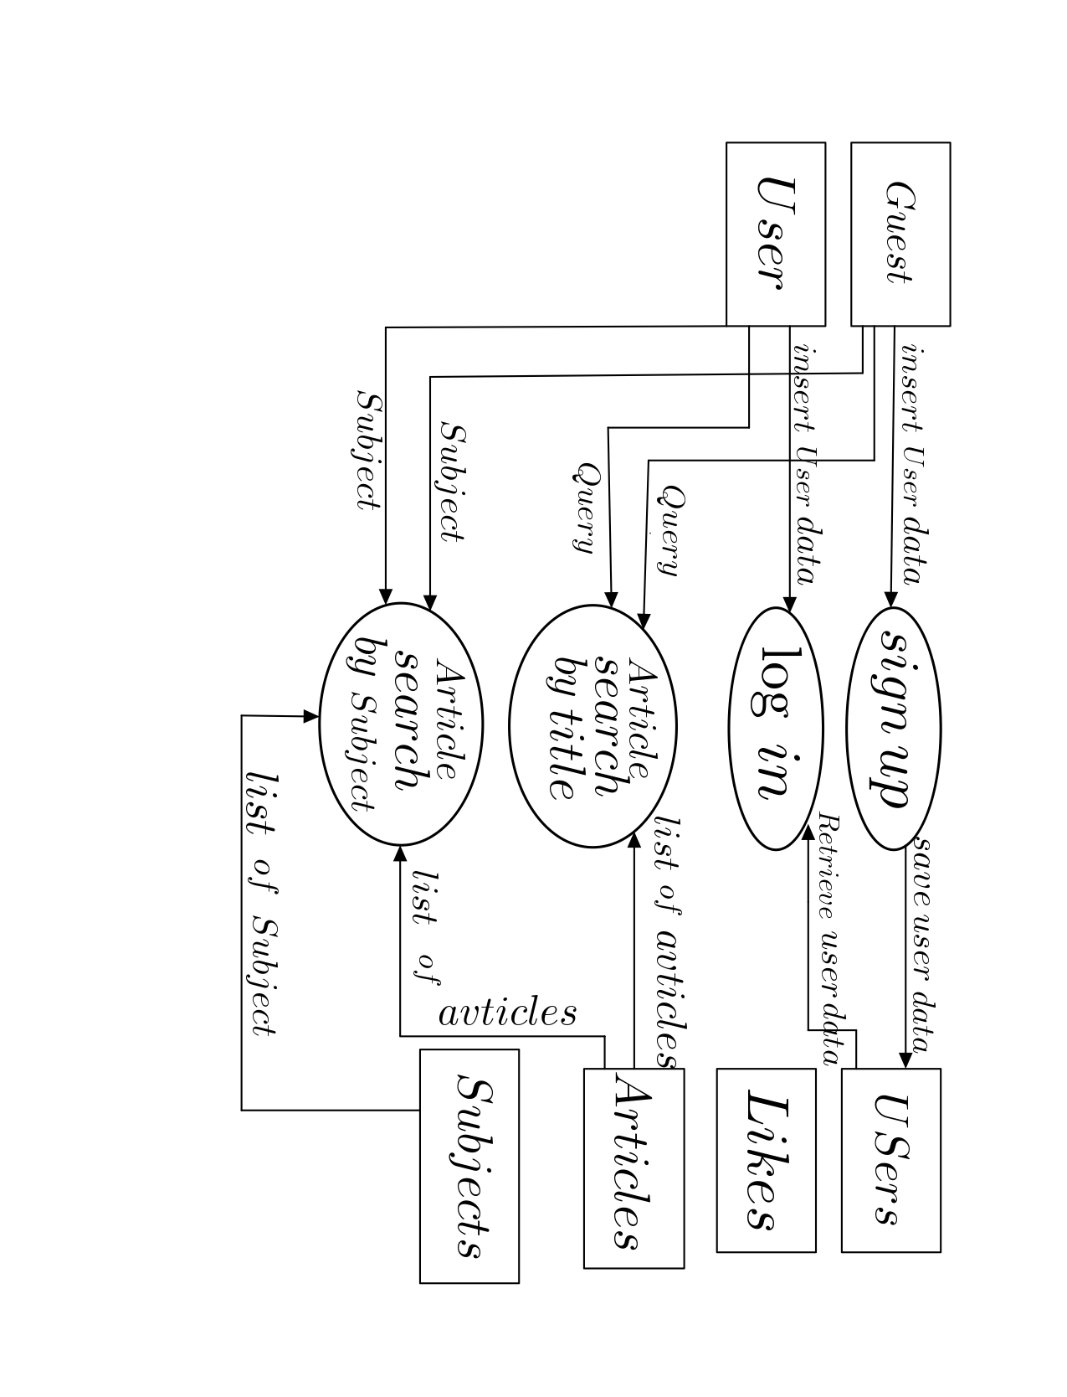
DFD

Slide 4
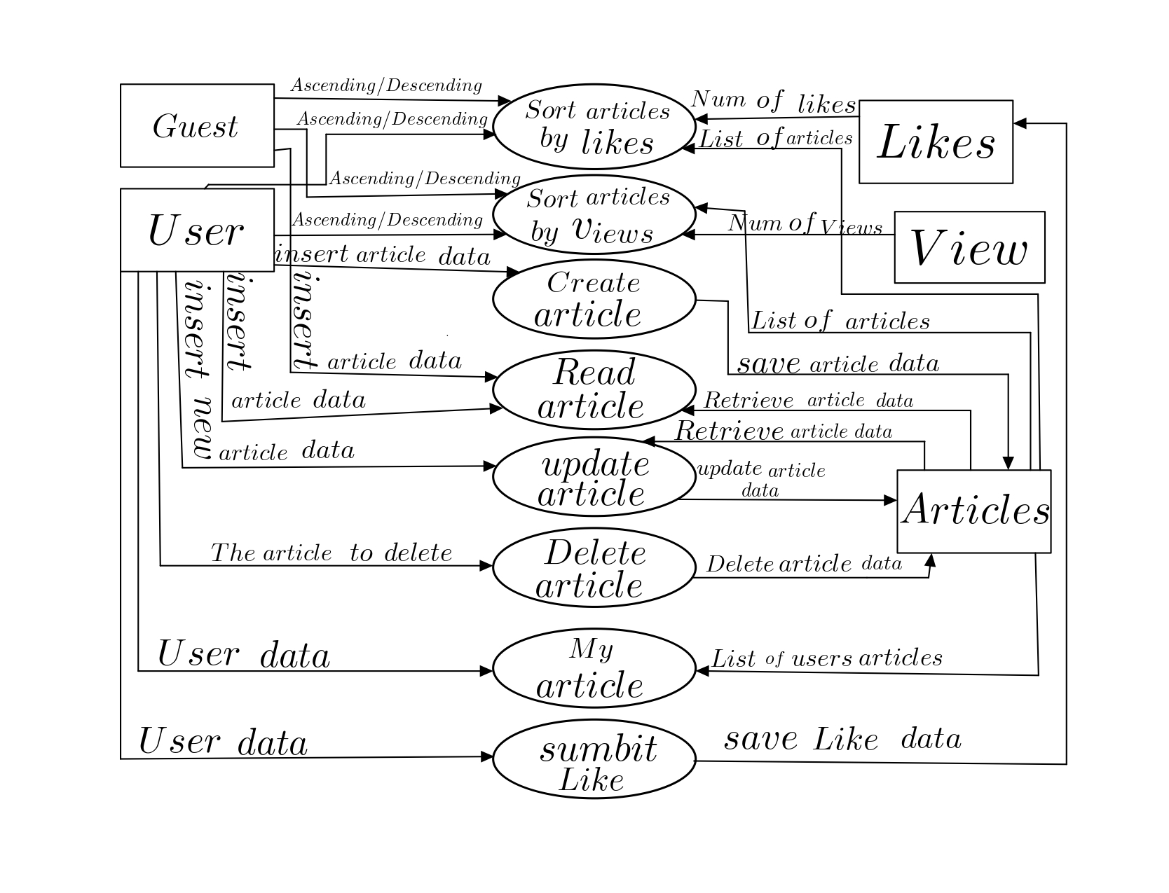
DFD

Slide 5
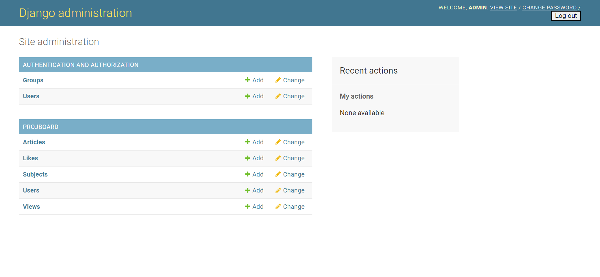
Data model via Django Admin UI

Slide 6
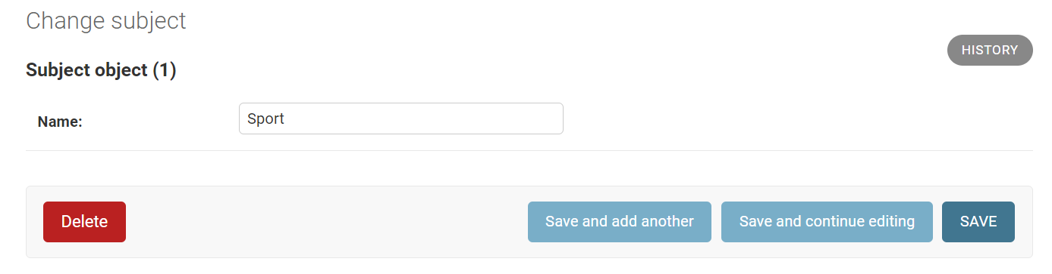
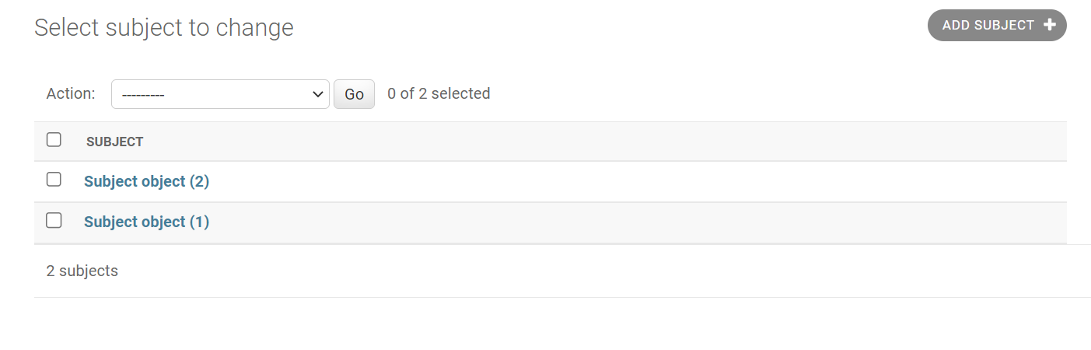
Subject

Slide 7
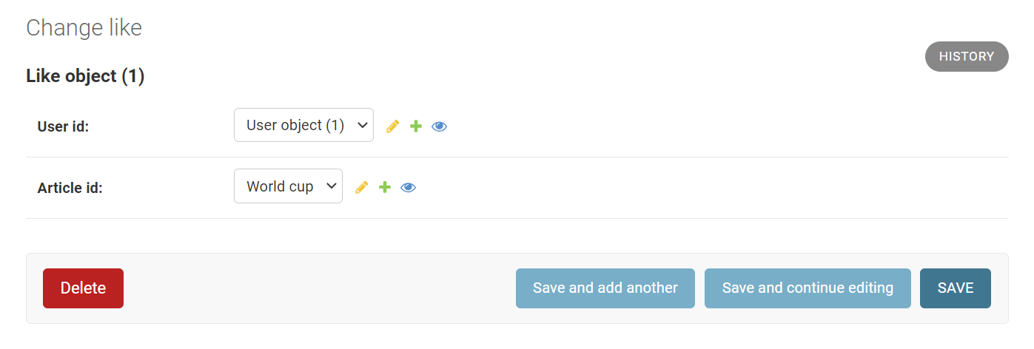
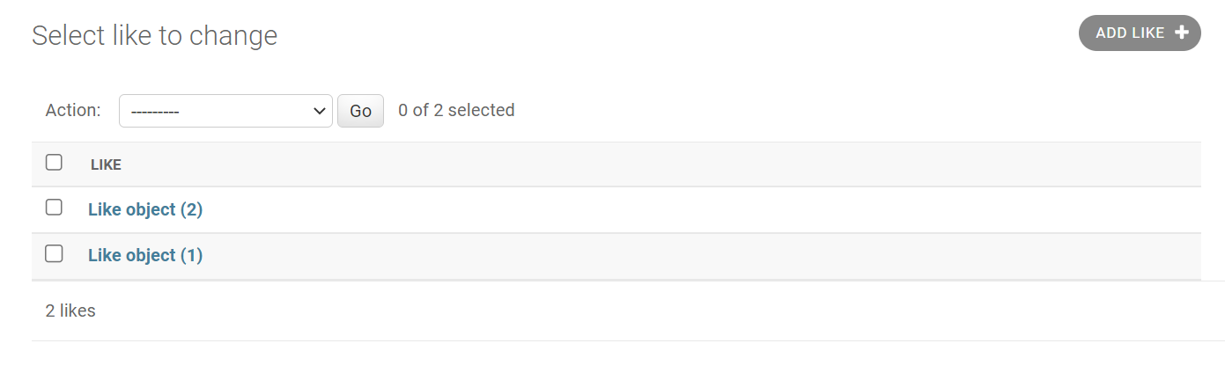
Like

Slide 8
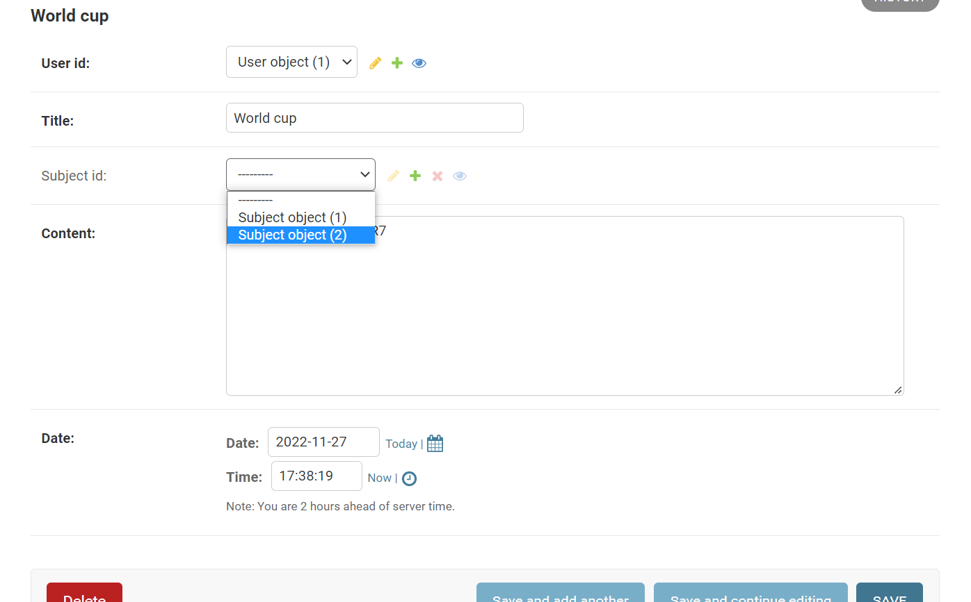
Article Object

Slide 9
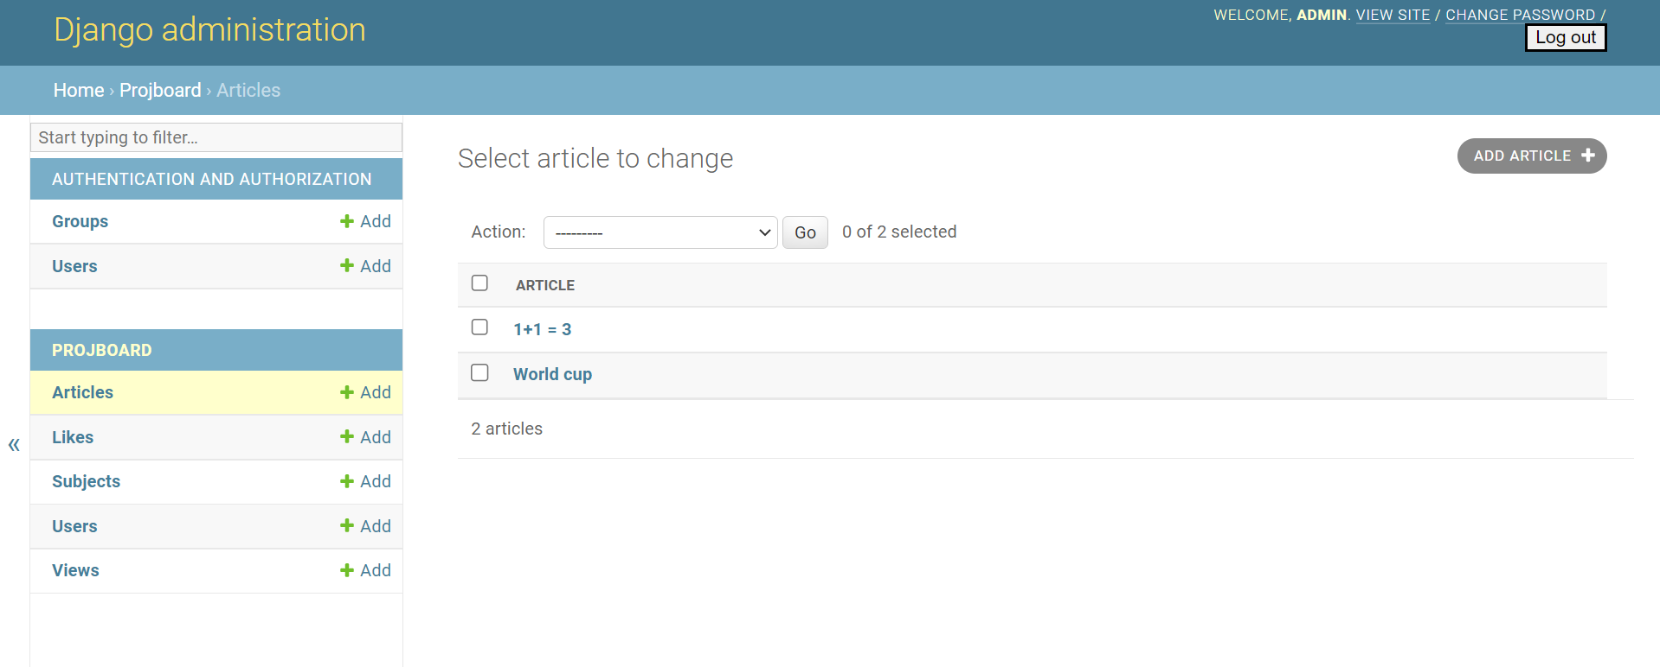
Article Rows

Slide 10
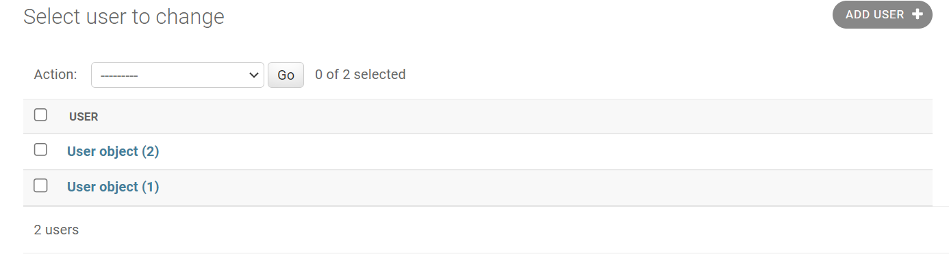
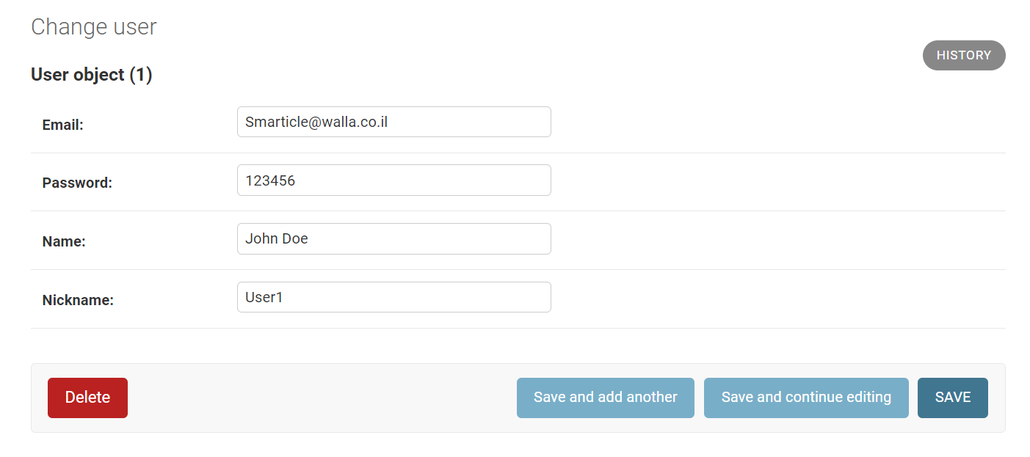
User

Slide 11
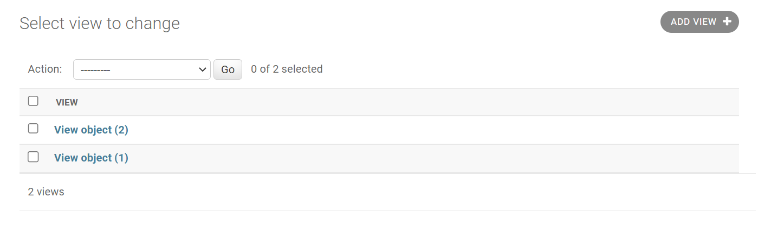
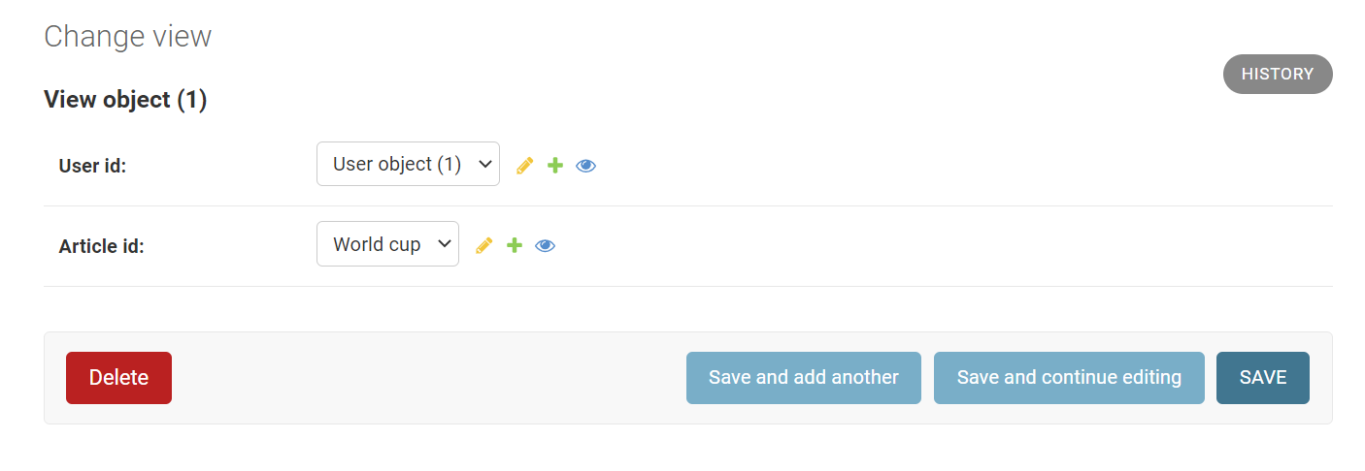
View

Slide 12
Our group division for the 2nd demo:
Yael: Subject model
Rawad: User model
Shalev: Like model
Amit: Views model
Anas: Article model

